Slide 1
Mid-term thesis presentation (10/03/2023)
THE EFFECTIVITY OF WEIRS FOR THE LOCAL GROUNDWATER RECHARGE IN THE CATCHEMENT OF THE GONDEBEEK
–
Anne-Marie Braspenning

Slide 2
DATA ANALYSIS

Slide 3
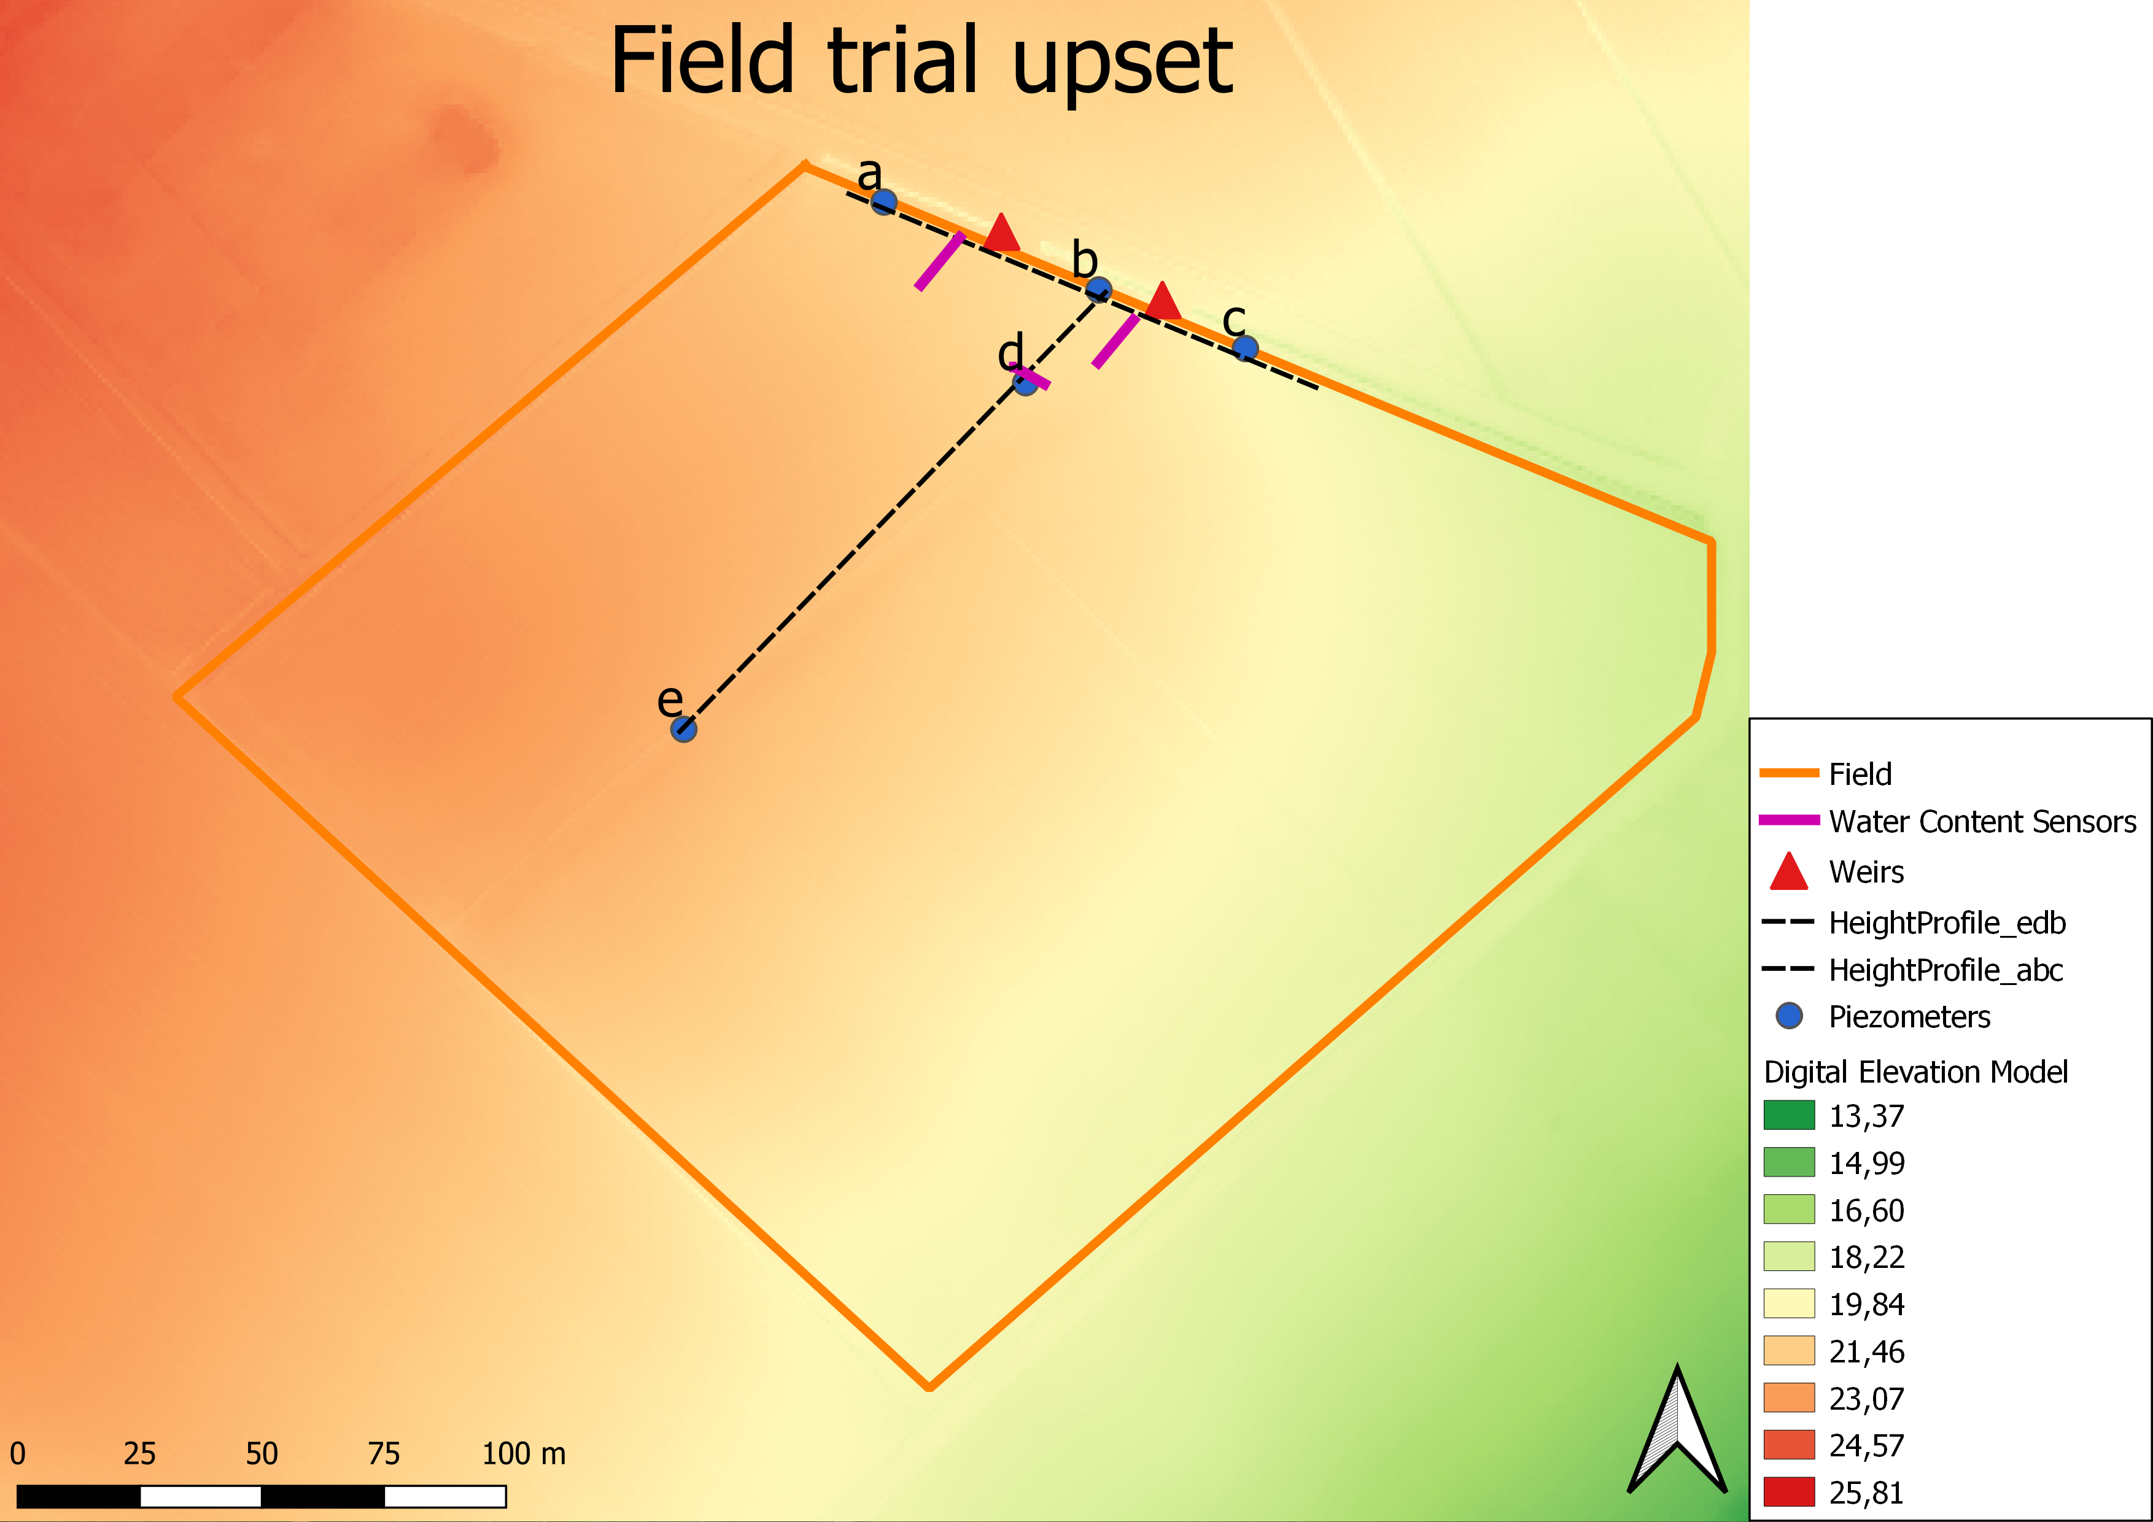
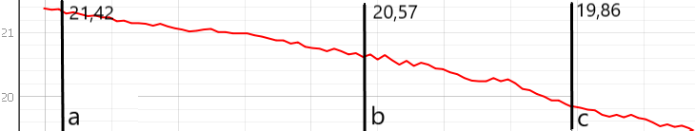
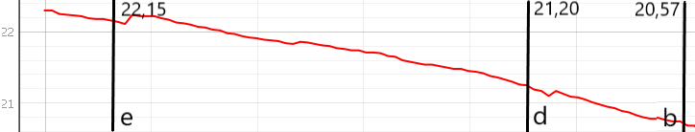

Slide 4
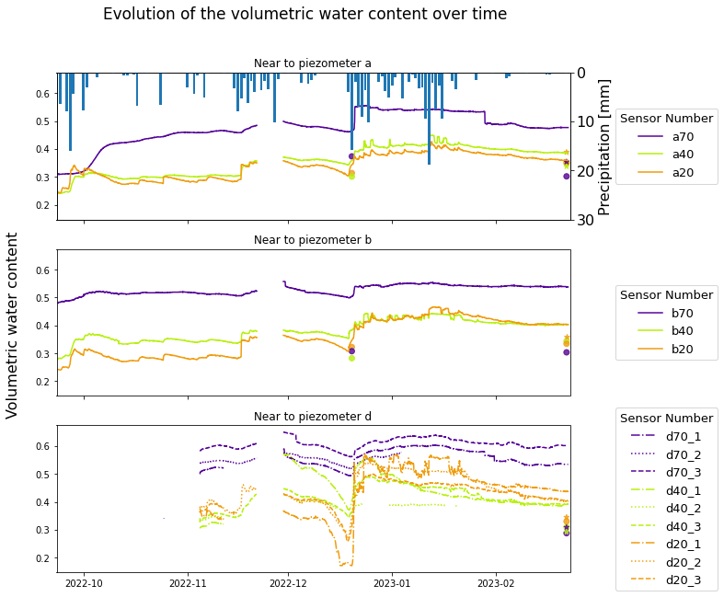
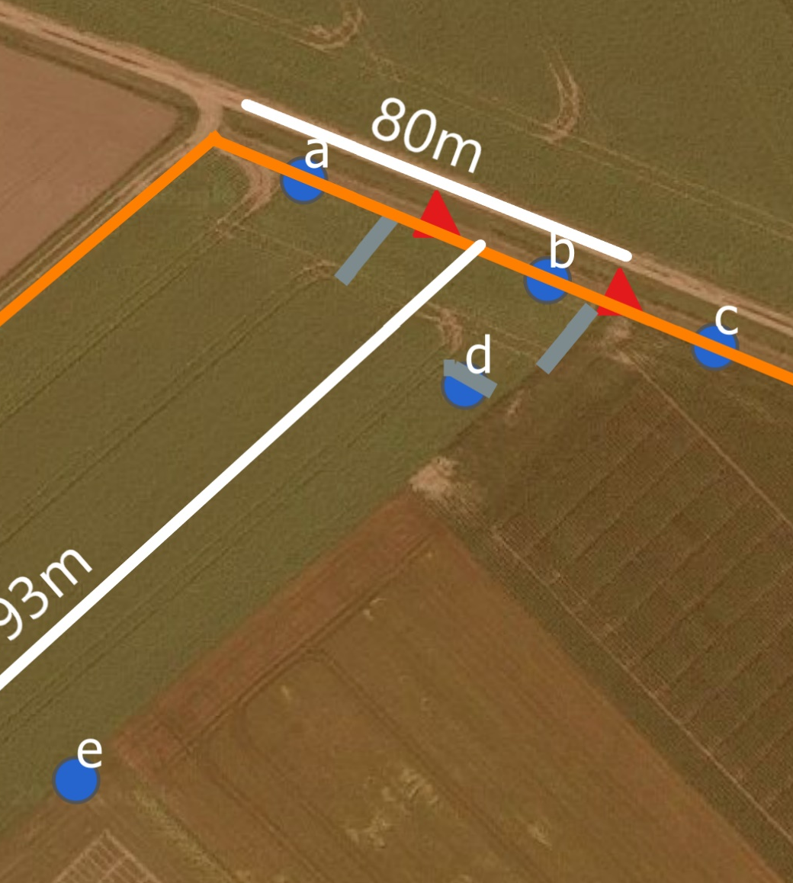

Water Content Sensors
Volumetric water content
Based on gravimetric water content: θv = θg * BD
Volumetric water content measured with Kopecky ring

Slide 5
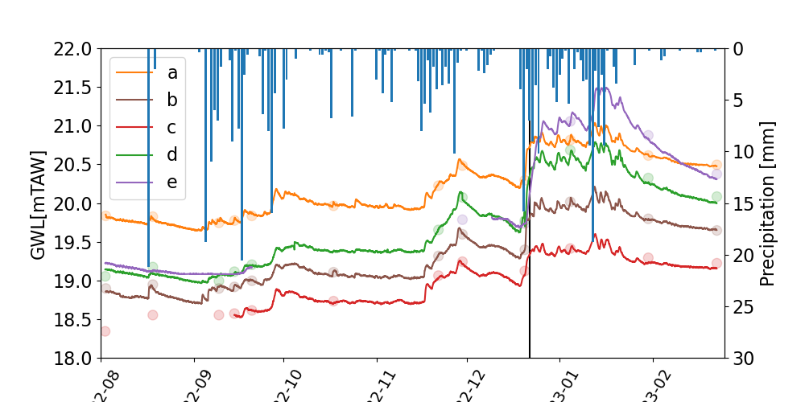
Piezometers: Groundwater level [mTAW]

Slide 6
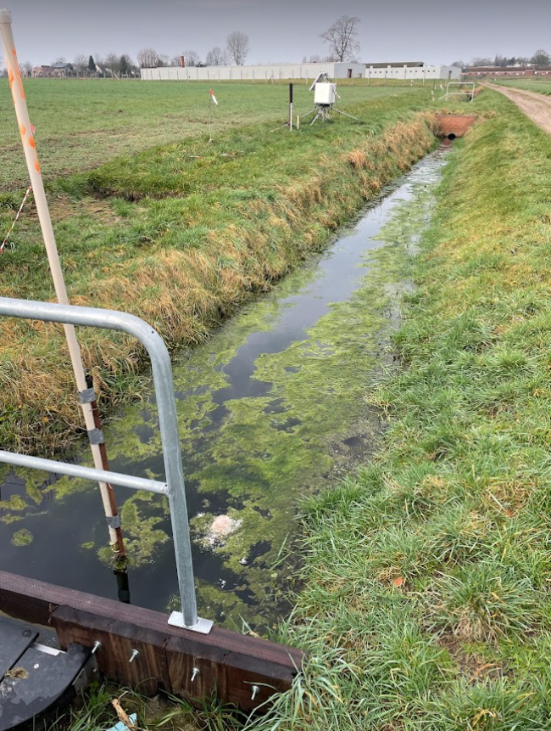
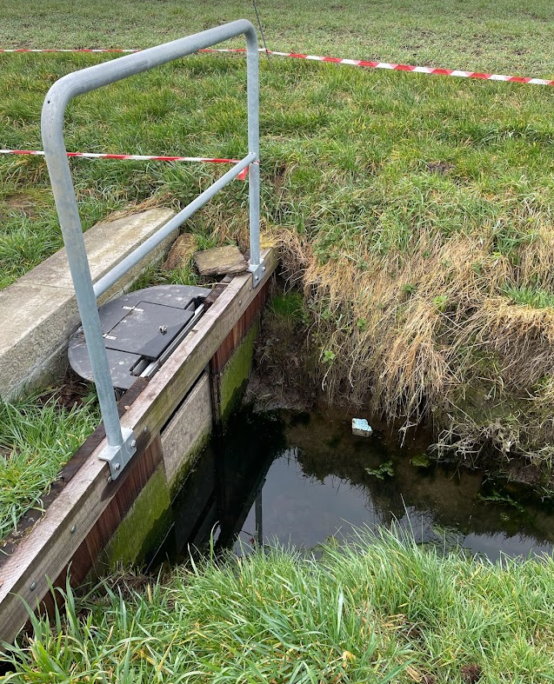
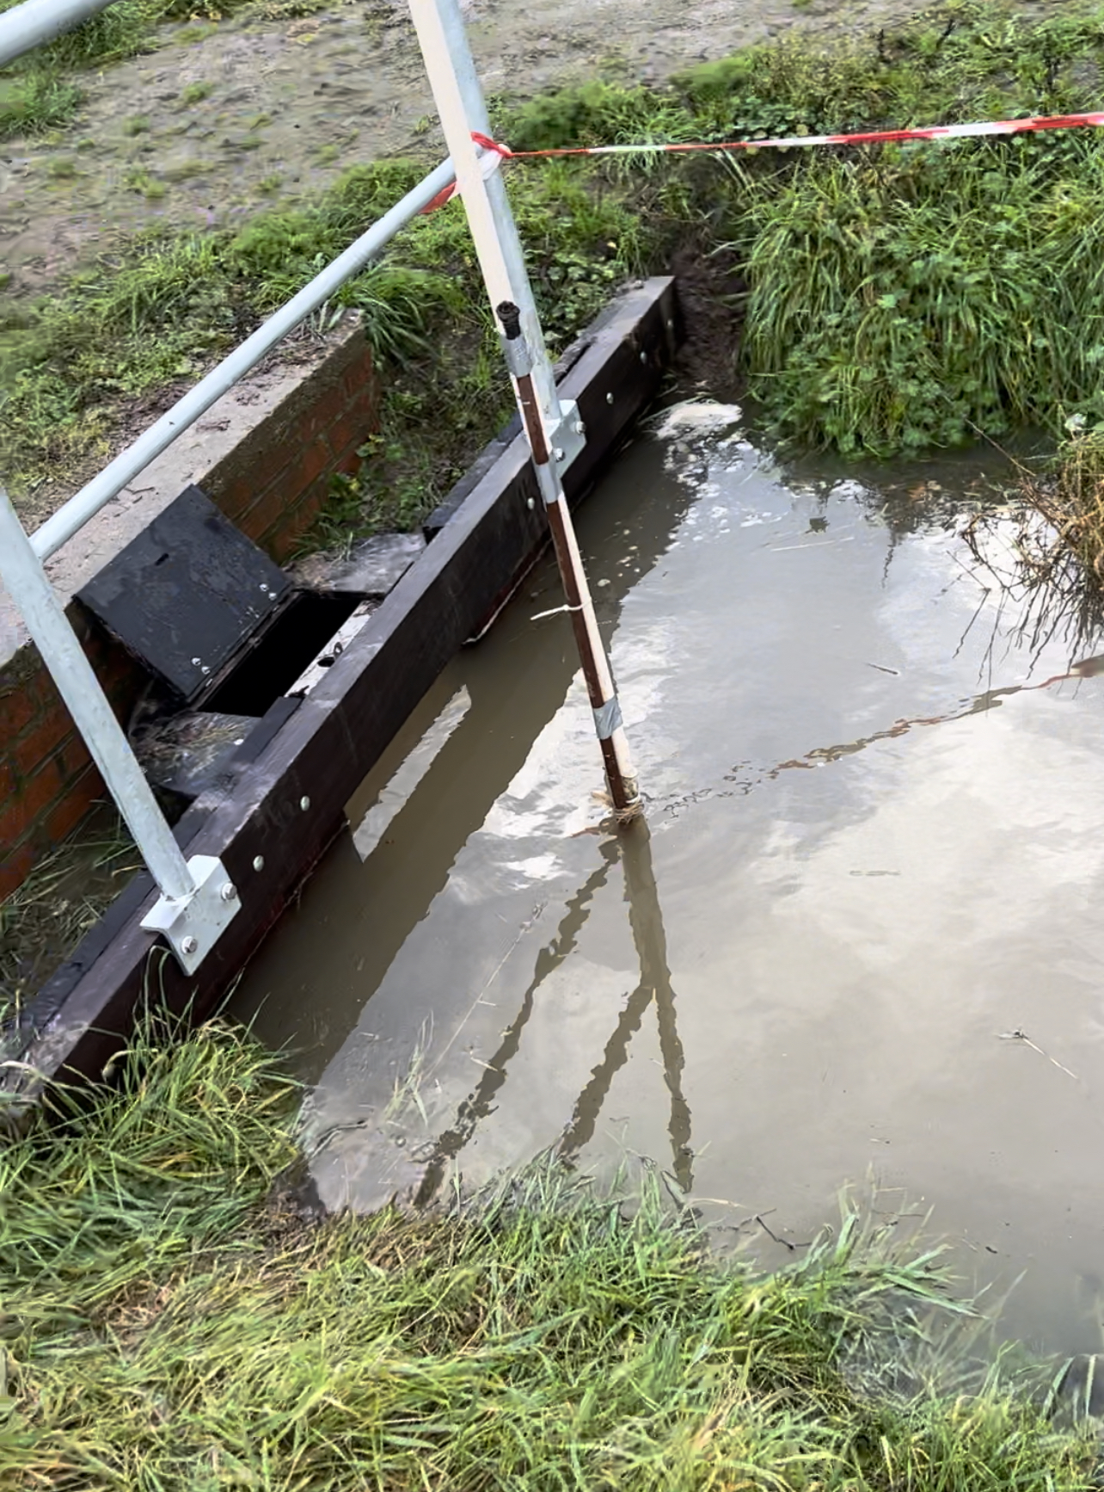
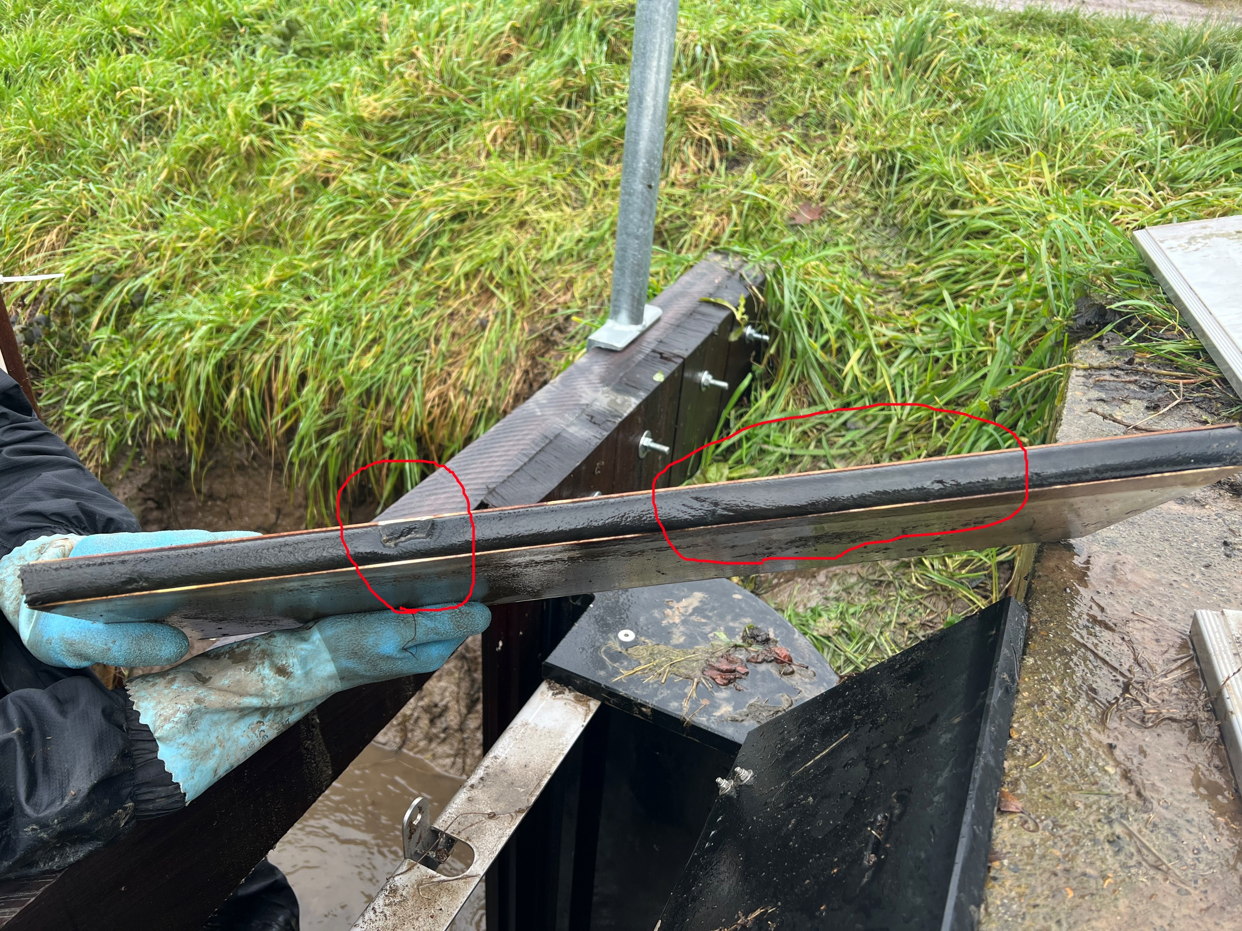
22/02/2023
Weir 2
Weir 1
23/12/2022

Slide 7
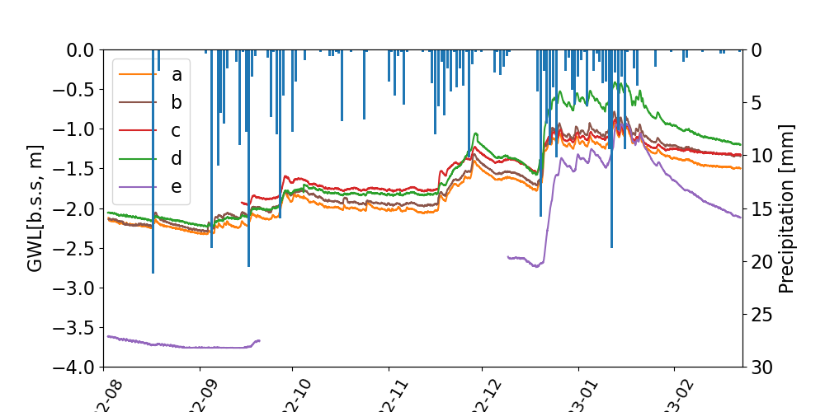
Piezometers: Below surface depth [m]

Slide 8
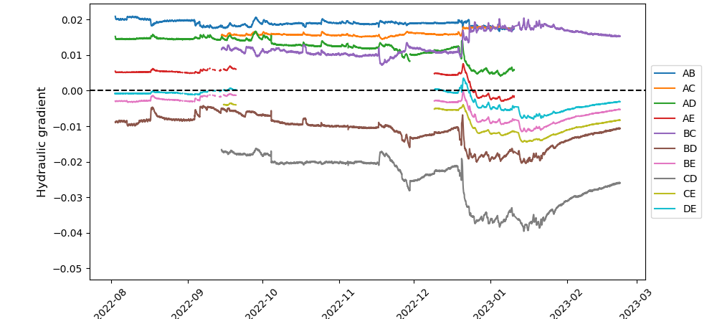
Piezometers: Hydrualic gradients

Slide 9
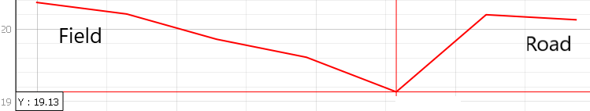
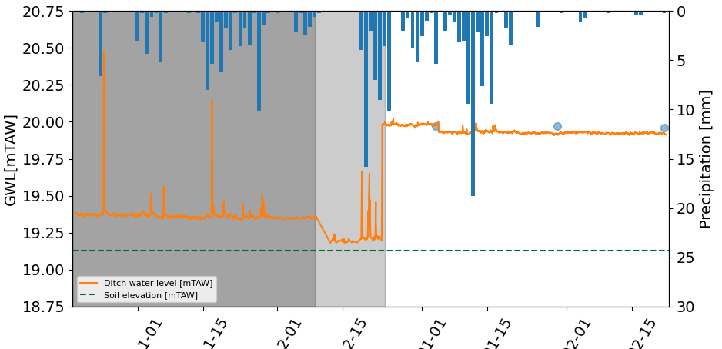
Ditch water level

Slide 10
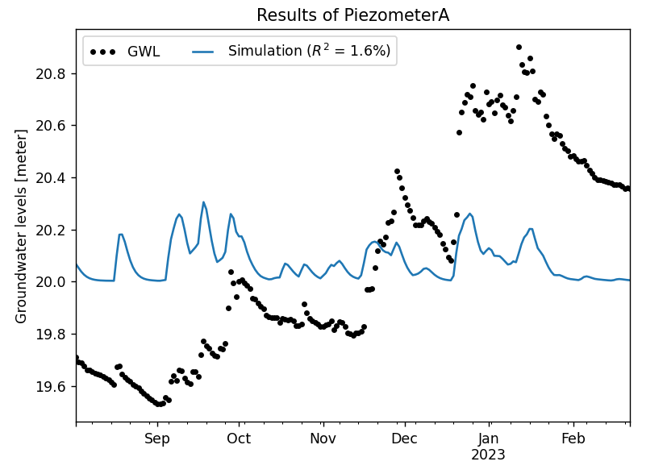
What is next?
Last data point?
Open weirs?
Time series analysis: ‘PASTAS’
With precipitation
Link with ditch water level?

Slide 11
HYDRUS MODELLING

Slide 12
2D simulation for 1 piezometer (B)
Produce similar trend?
22/09/2022 – 30/01/2023 (131 time variable boundary conditions)
BC: variable head → variable ditch water level at 70cm
IC: pressure head: equilibrium at 1800cm (2m below surface level)
Root Water Uptake (no root growth) ~ Root distribution parameters

Slide 13
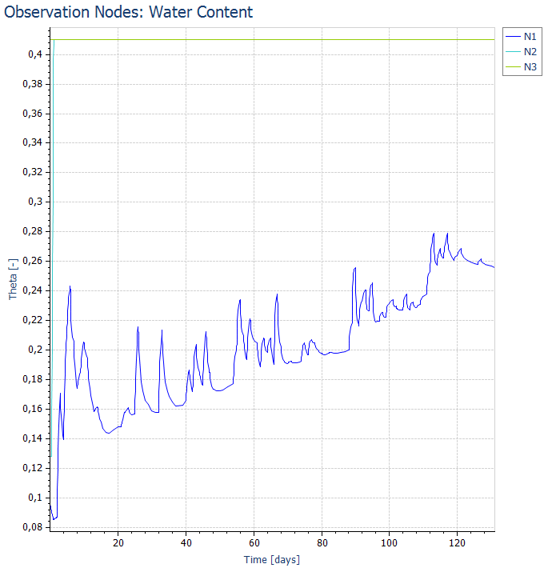
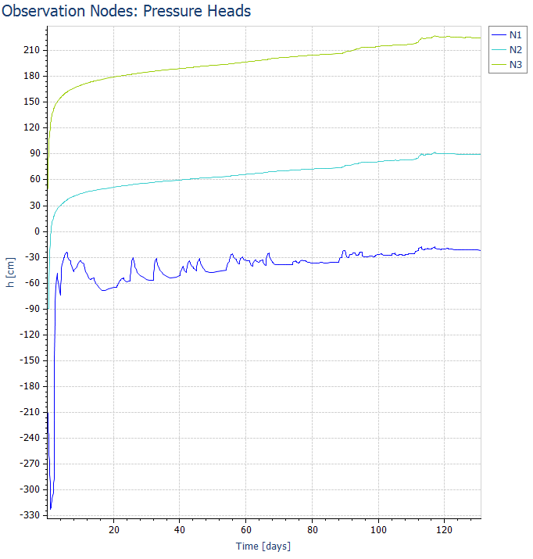
2D simulation for 1 piezometer (B)
Actual surface flux > Actual root uptake
Groundwater level strongly determined by ditch water level
N1: 0m depth N2: 1m depth N3: 2,5m depth

Slide 14
3D simulation: 3D layered with thickness vectors
22/09/2022 – 30/01/2023 (131 time variable boundary conditions)
Field domain, piezometers as observation nodes
IC: pressure head: Equilibrium h=2844 (1m below lowest surface point)
BC: ‘one layer’ of variable head (70cm)
Root Water Uptake
=1 upper 90cm
=0 below 90cm

Slide 15
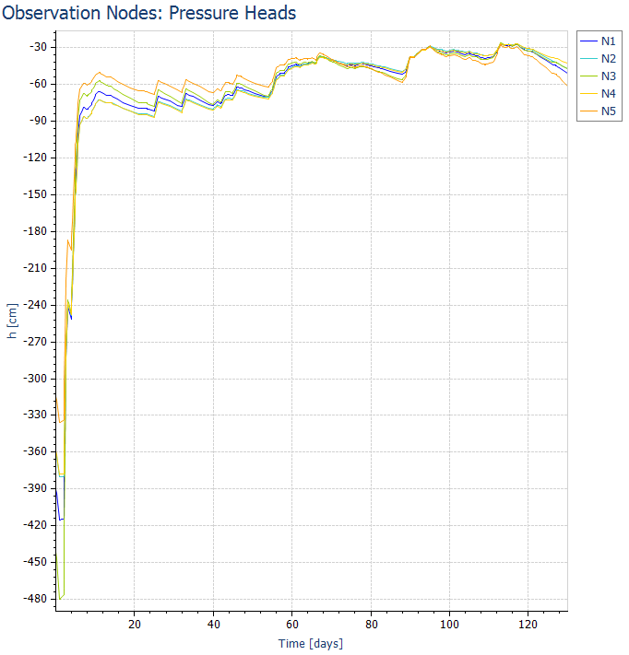
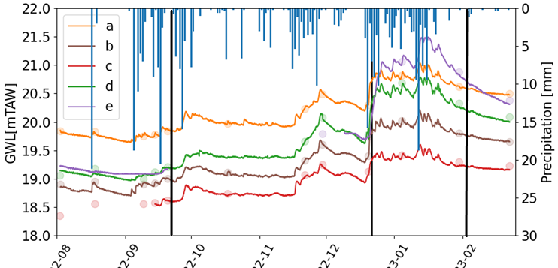
Pressure heads
N1 | E
N2 | D
N3 | A
N4 | B
N5 | C

Slide 16
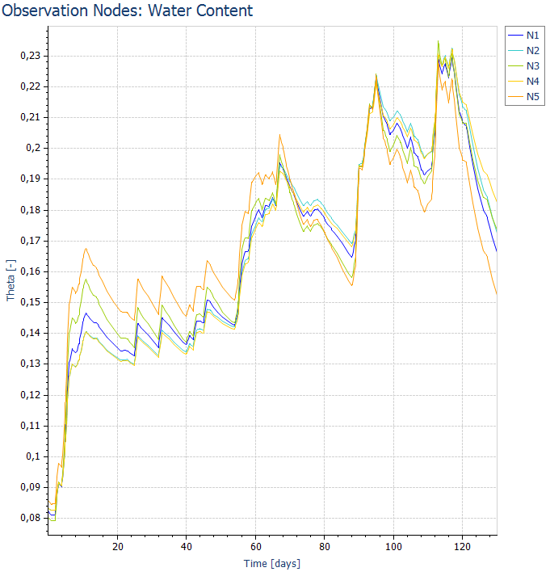
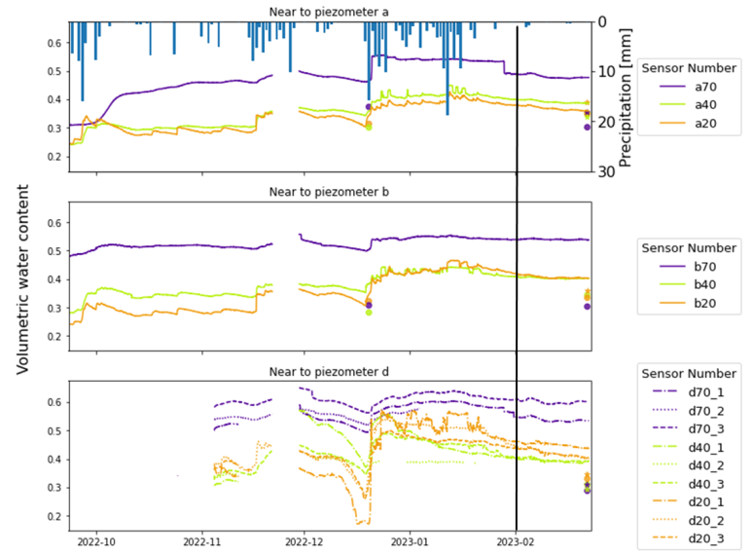
Water content
N1 | E
N2 | D
N3 | A
N4 | B
N5 | C

Slide 17
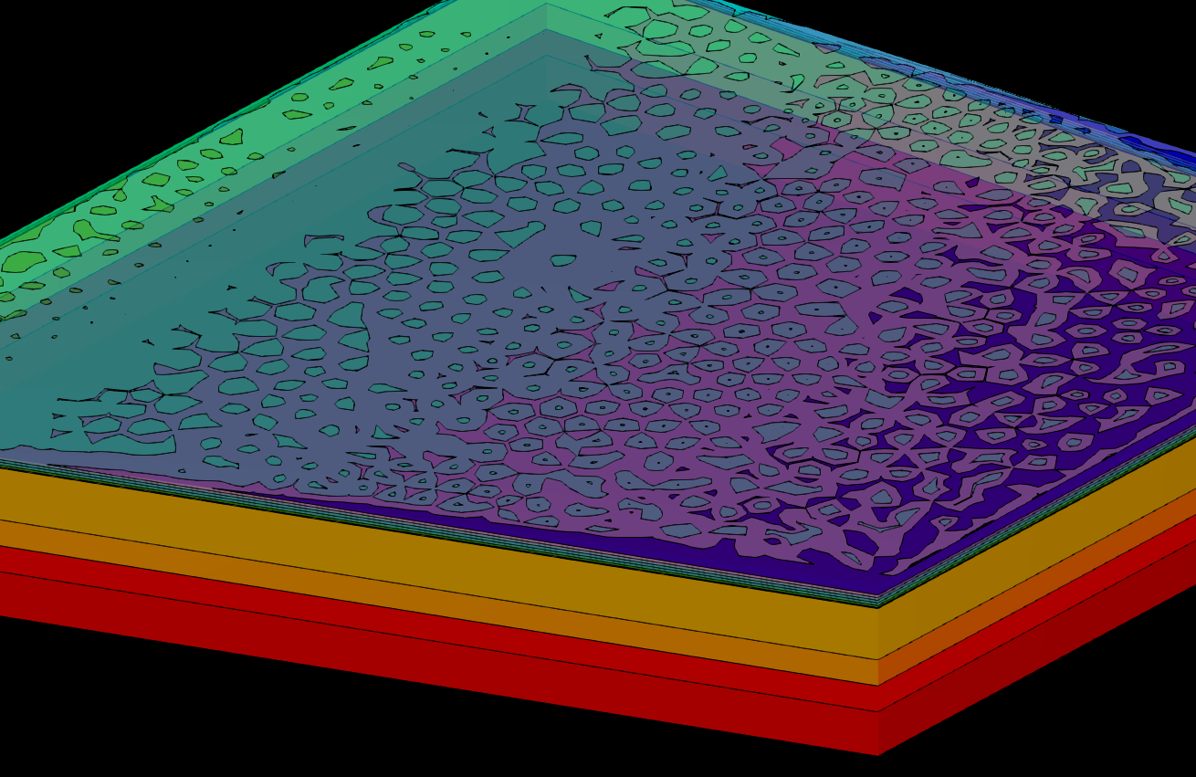
Mottled pattern (pressure head and water content)

Slide 18
How to implement different groundwater levels?
Tensors of anisotropy
Higher Ksat-value at boundary ditch
Switch to 3D-General?

Slide 19
Planning
31/03 (5 weeks): Time series + Hydrus (practical work + material & methods)
Easter holidays: Literature study + material methods + first results
Personal deadline: 07/05 (3 weeks): finalize the results

